Slide 1



Slide 2
TEAM MEMBERS
Apoorve Goyal
Samiksha Agrawal
Maaz bin Asad

Slide 3
Overview
Idea:
The main objective of our hack is:
To provide a platform to verified doctors where they can create posts regarding any disease(symptoms, treatment, precautions, etc.).
Users can view these posts, filter them, get real time data(in case of COVID-19 like pandemic), and even send request to connect to doctors available there.
User can also search for best hospital(ranging from Buildings to simple clinic) for a particular disease*
* To be added

Slide 4
TECH STACK USED
HTML5, CSS3, Bootstrap, Javascript, Jquery – Frontend Frameworks
Firebase – Authentication for Users, Storing and fetching data from firestore.
Google Maps API – For locating the hospitals on the Map*
Django, PostgreSQL – Authentication for Doctors
* To be added

Slide 5
BUISNESS POTENTIAL

Slide 6
Flowchart
User/Medical Experts
User
See Post/Trending
Connect to Doctors
Locate Hospital
Medical Experts
Not Registered
Registered
Create Posts
Register and wait for verification.

Slide 7
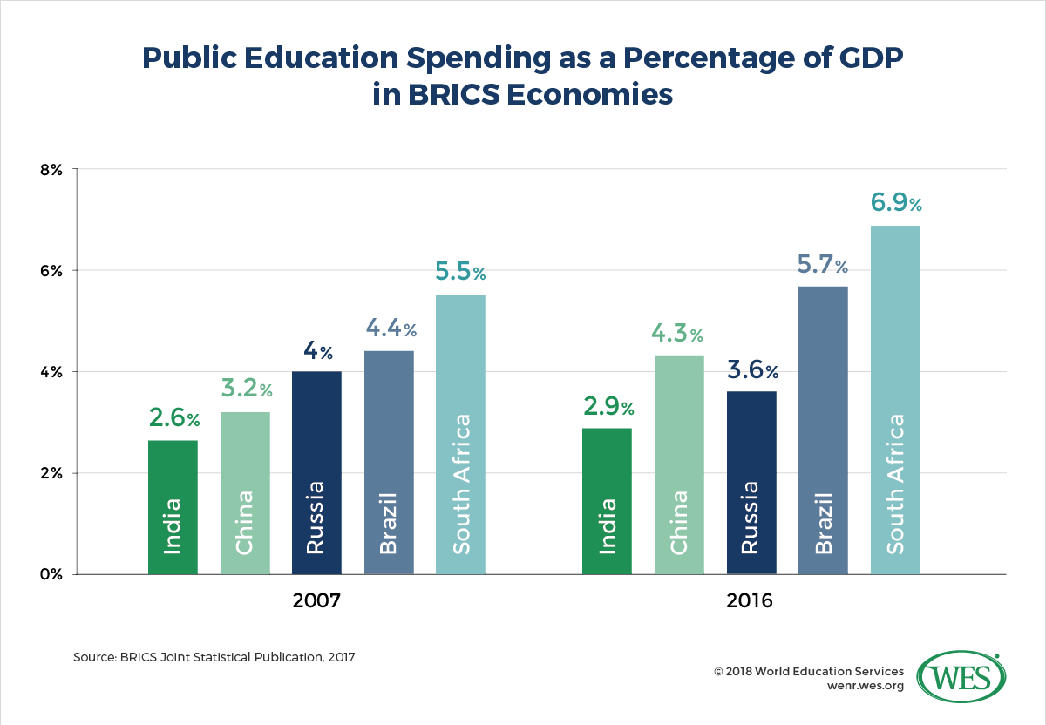

Slide 8
